Slide 1
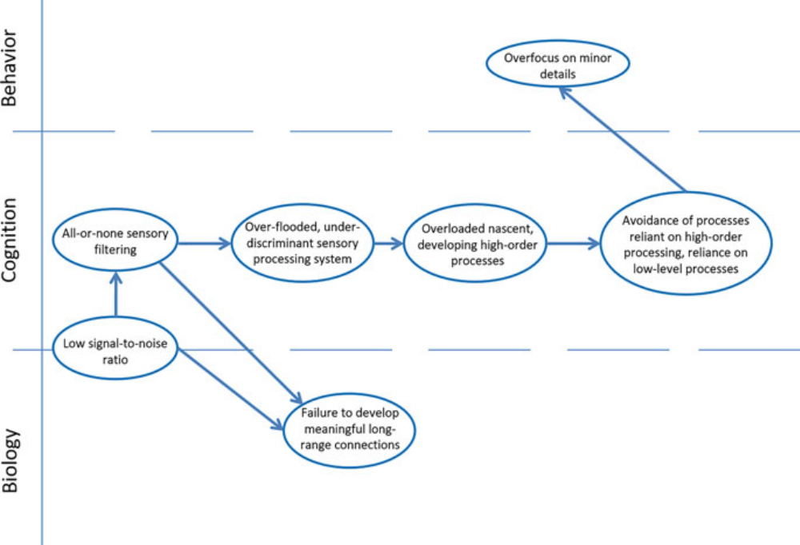
Challenges with novel face recognition
Decreased use of contextual information
Decreased performance on Executive Function Tasks
Increased rote memory
Hyperlexia
Decreased semantic memory
Overfocus on minor details/Weak Central Coherence
Altered ToM Task Performance
Decreased Shared Affect
Altered Joint Attention
Decreased early social experience
Specialized experience-dependent capacity for language
Specialized experience-dependent capacity face processing
Specialized experience-dependent capacity for complex social relations
preference
for ritualized, scripted, and repeatable interactions
style of
unsupervised learning founded on statistical associations
rather than learning that is directed by the
intentionality of others

